Slide 1
Sensor Systems and the Art of Effectively Deploying Sensor Networks
Pat Pannuto
University of Michigan
TechChange – TC111

Slide 2
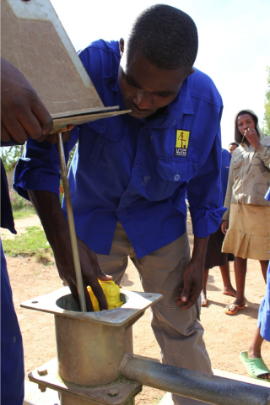
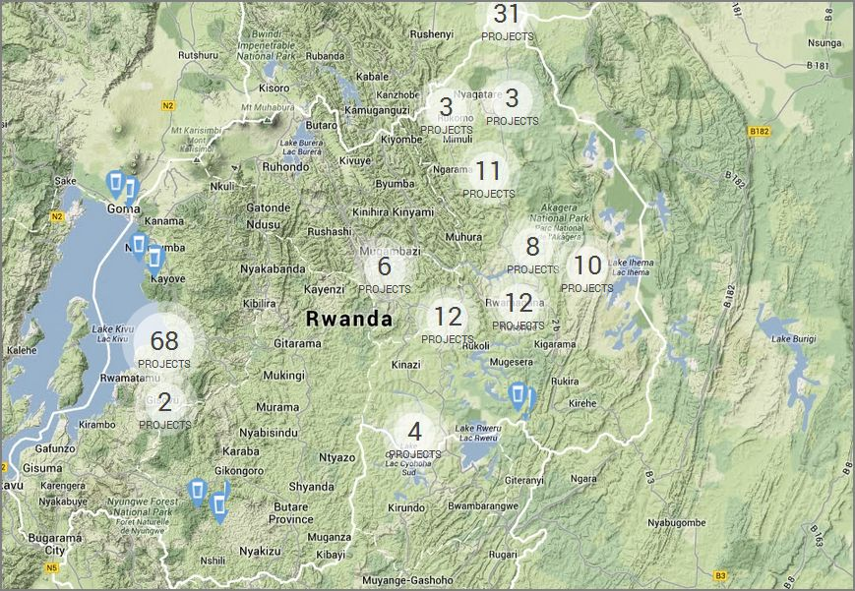
CellPump: Using sensors to improve efficacy
30-80% of water pumps fail within 1 year of installation
What happens when a pump fails?
http://www.pdx.edu/sweetlab/cellpump-rwanda
http://www.sweetsensors.com/applications/cellpump/

Slide 3

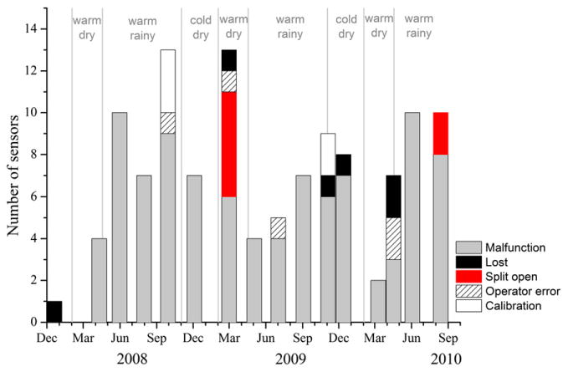
Stove Usage Monitors: Establishing reliable usage data
How much are free cookstoves actually used?
https://www.youtube.com/v/qmY8PRmi3lQ

Slide 4

Inspire Living: Sensors for Immediate Impact
Pneumonia can be reliably diagnosed from key signals
Respiration rate is key
Hard to train people to diagnose, easy to train a machine
Use sensors to measure and evaluate respiration

Slide 5
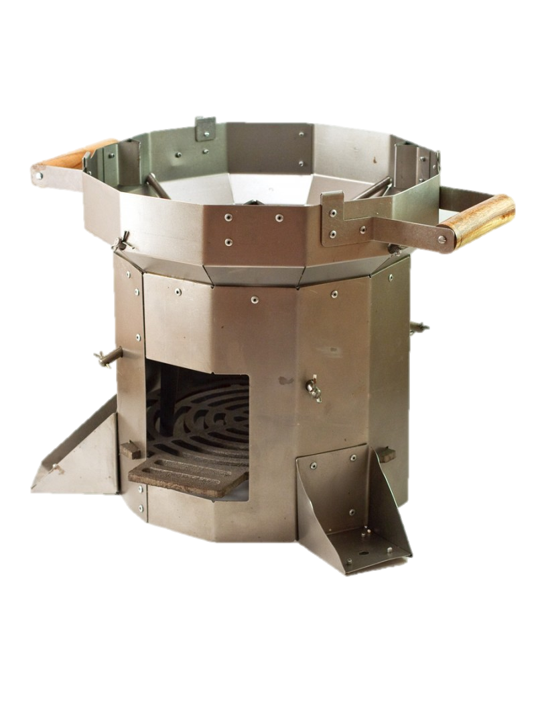
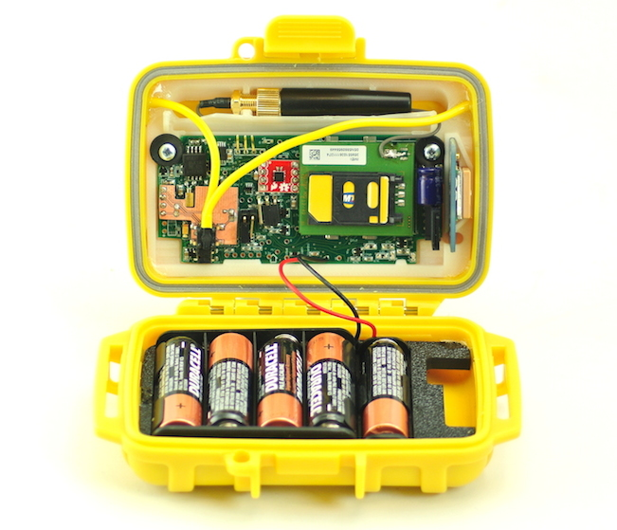

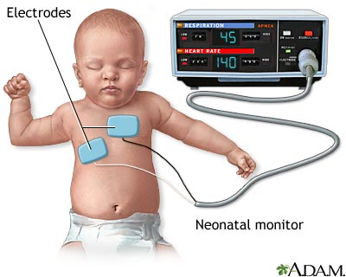
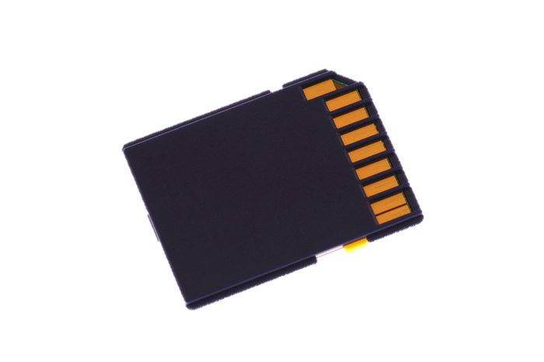

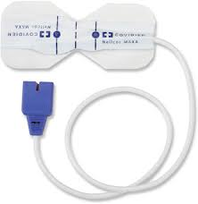
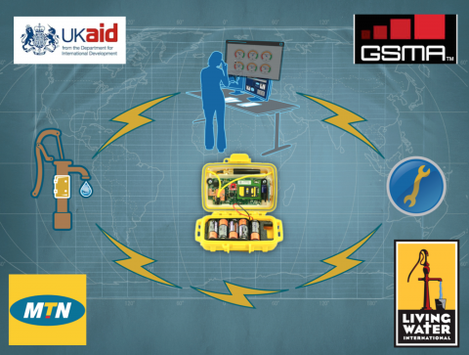
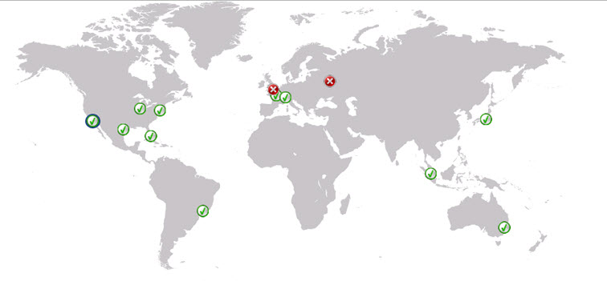
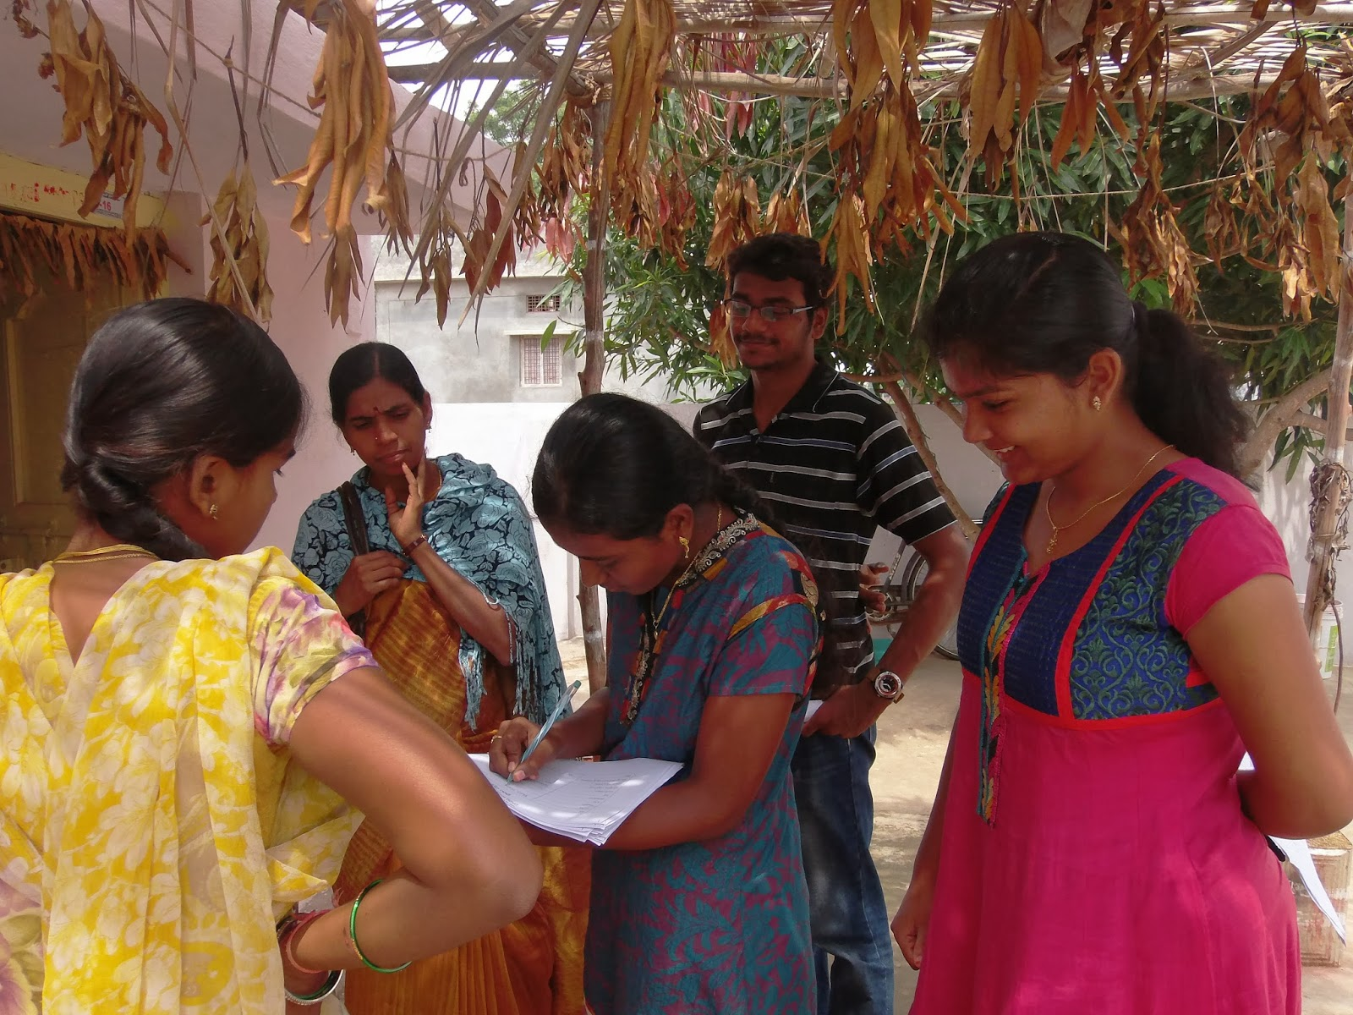
Application requirements define data behavior
CellPump Stove Usage Monitors Inspire Living
Has Pneumonia
Consult Doctor
Real-Time Batch Local Loop

Slide 6
Developing a sensor-based deployment requires understanding…
What semantic data you need?
What is the question you’re actually trying to answer?
What physical data you need?
What can you actually sense about the world?
What do you have available?
Existing data sources, infrastructure
How is the data intended to be used?
Which informs how the data is collected, disseminated
A sensor deployment is a series of interconnected tradeoffs
Notes:
Semantic: Is the water pump working? Stretch: how much is it being used? Physical: Water flow meter (expensive, fluids are hard). Handle motion (easy to measure, hard to conceal). Vibrations inside the pump? → requires experimentation
Resources: Synergistic data sources
Use: Real-time vs. batch. Personal data / protection? Feedback to users (and the ramifications of lifestyle adjustment due to your tech)

Slide 7
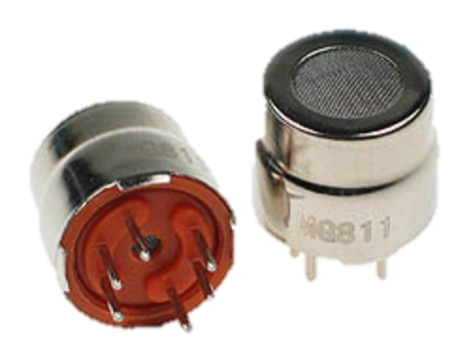
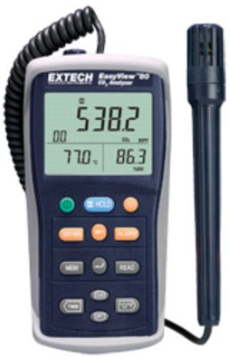
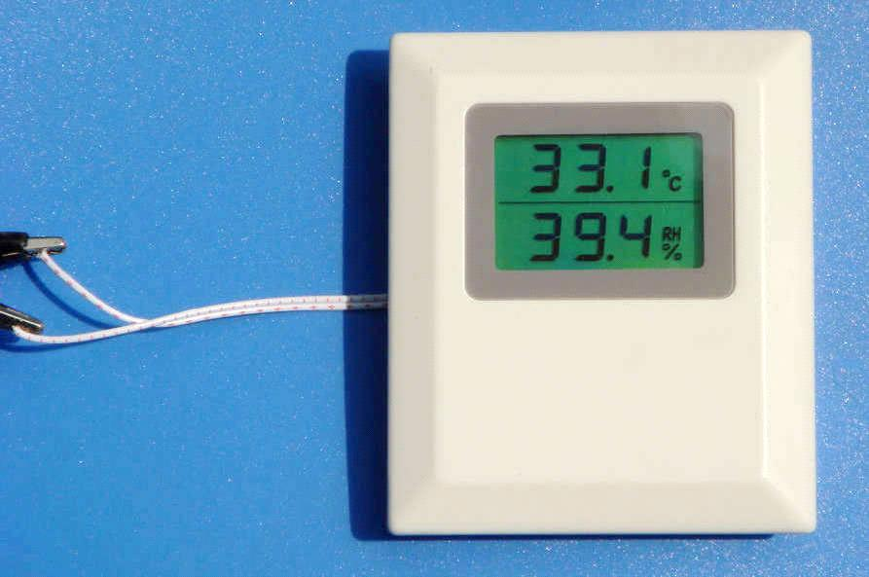
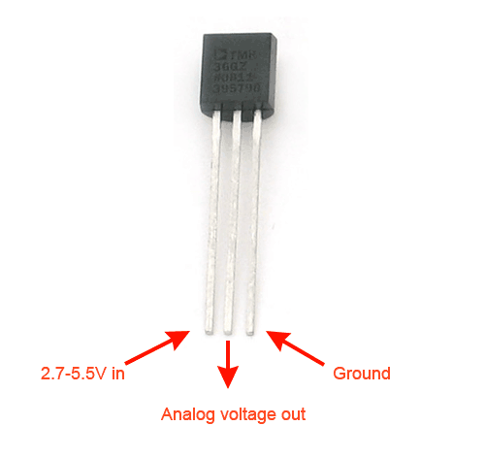
Sometimes semantic and physical data requirements line up
How does interior temperature change through the day?
Use a temperature sensor
What about humidity, carbon dioxide, air particulates…?
In general, there are sensors for environmental monitoring

Slide 8
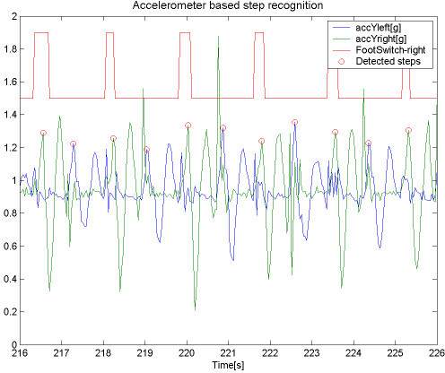
Many times we have to look at side effects to sense phenomenon
Simple Example
Did I close the window → Contact sensor
Did I close the blinds → Ambient light sensor
Complex Example
Fitbit “counts steps”
Measures accelerometer data
Classifies motion traces
(machine learning usually)

Slide 9
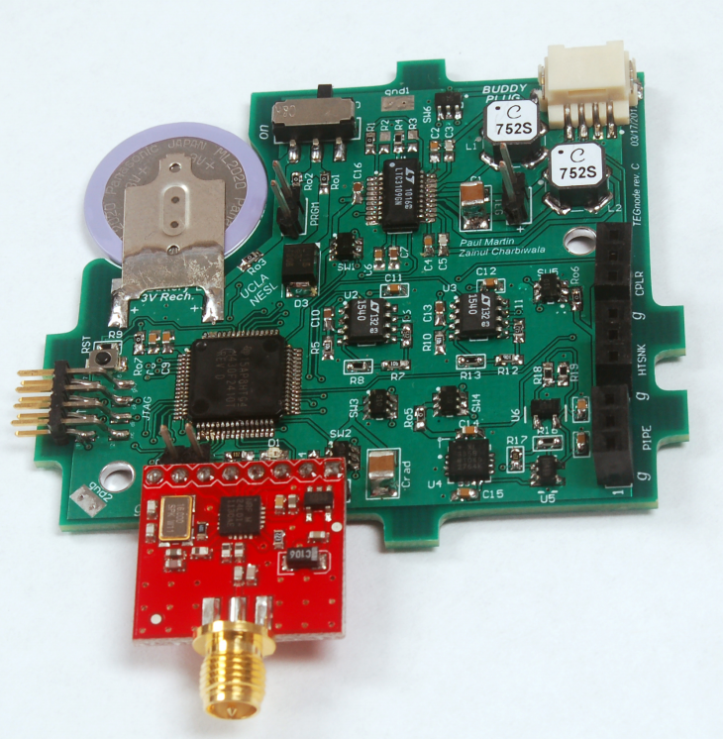
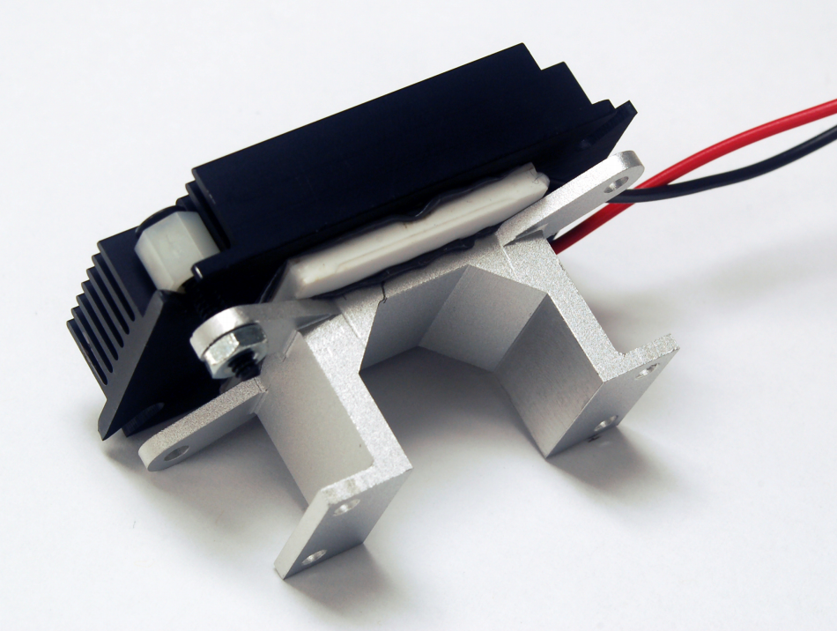
Choosing a means to sense can be non-obvious
“I need a sensor that measures water flow”
Mechanically challenging
“It needs to be wireless and last for several months”
“I want to measure if people wash their hands after they use the toilet”
You actually want a temperature sensor
Paul Martin, Zainul Charbiwala, Mani B. Srivastava
DoubleDip: leveraging thermoelectric harvesting for low power monitoring of sporadic water use
In Sensys’10

Slide 10
Group Question: How can we answer the same question without plumbing?
Goal: Measure hand washing rate after bathroom usage
Stretch goal: Distinguish by bathroom activity
Restrictions:
No plumbing
No power
No direct user involvement (“push here after washing”)

Slide 11
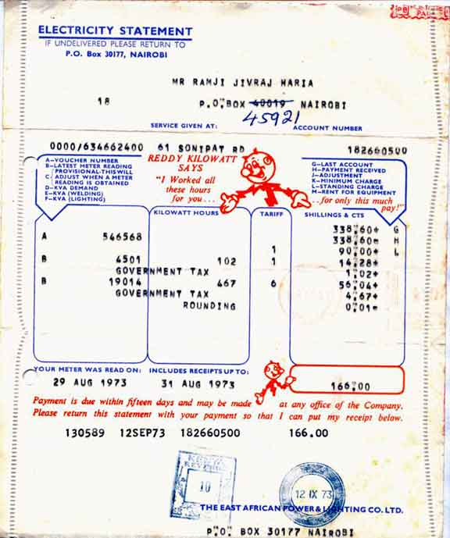
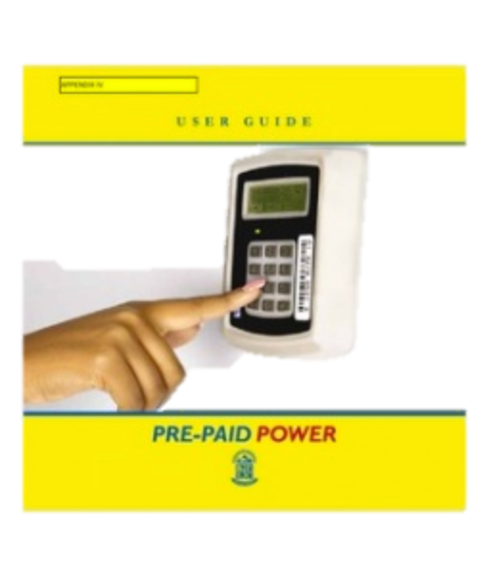
What data sources are already available?
Sometimes what you want is collected and published
KPLC weekly power outage reports
Use partial information to confirm or question measurements
Notes:
KPLC has problems – trust the utility? PDF document of data hard to use. Coarse-granularity

Slide 12
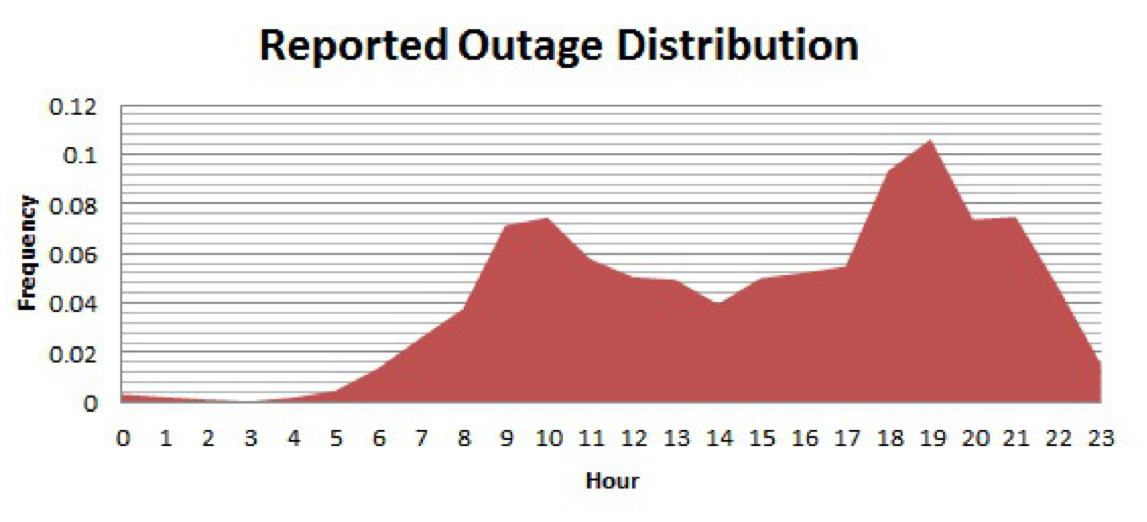
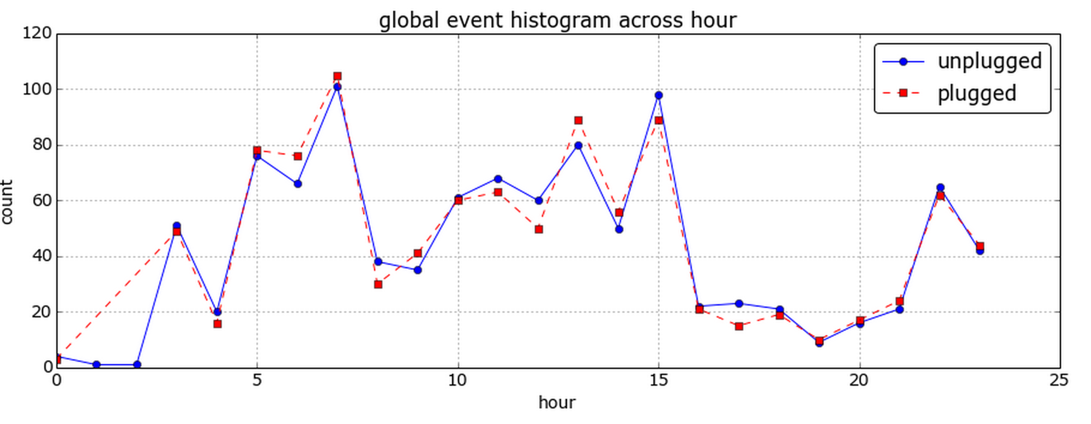
Think a little outside the box for possible data sources
Kenya: people tweet to notify / complain of power outages
Preliminary results from a deployment in Kenya

Slide 13
Drilling into data collection and tradeoffs
What semantic data you need?
What is the question you’re actually trying to answer?
What physical data you need?
What can you actually sense about the world?
What do you have available?
Existing data sources, infrastructure
How is the data intended to be used?
Which informs how the data is collected, disseminated
A sensor deployment is a series of interconnected tradeoffs
Notes:
Semantic: Is the water pump working? Stretch: how much is it being used? Physical: Water flow meter (expensive, fluids are hard). Handle motion (easy to measure, hard to conceal). Vibrations inside the pump? → requires experimentation
Resources: Synergistic data sources
Use: Real-time vs. batch. Personal data / protection? Feedback to users (and the ramifications of lifestyle adjustment due to your tech)

Slide 14
Define the data you intend to collect
How much data?
Synchrophasor (power grid health): 1000’s samples / sec
Soil Moisture: 1-10 samples / day
Mudslide Detection¹: 1 sample / 5 min <> 10 samples / sec
And what data do you actually need?
12:00 AM – It’s 74 degrees.
12:01 AM – It’s 74 degrees.
12:02 AM – It’s 74 degrees.
“Compressive sensing”
Lots of research: Report differences, trends, fit variables…
¹Real-time Wireless Sensor Network for Landslide Detection. Ramesh, M. V. SenSys’13

Slide 15
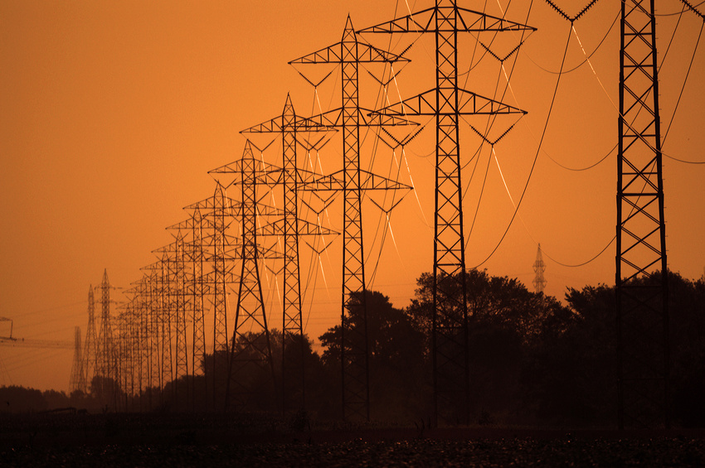
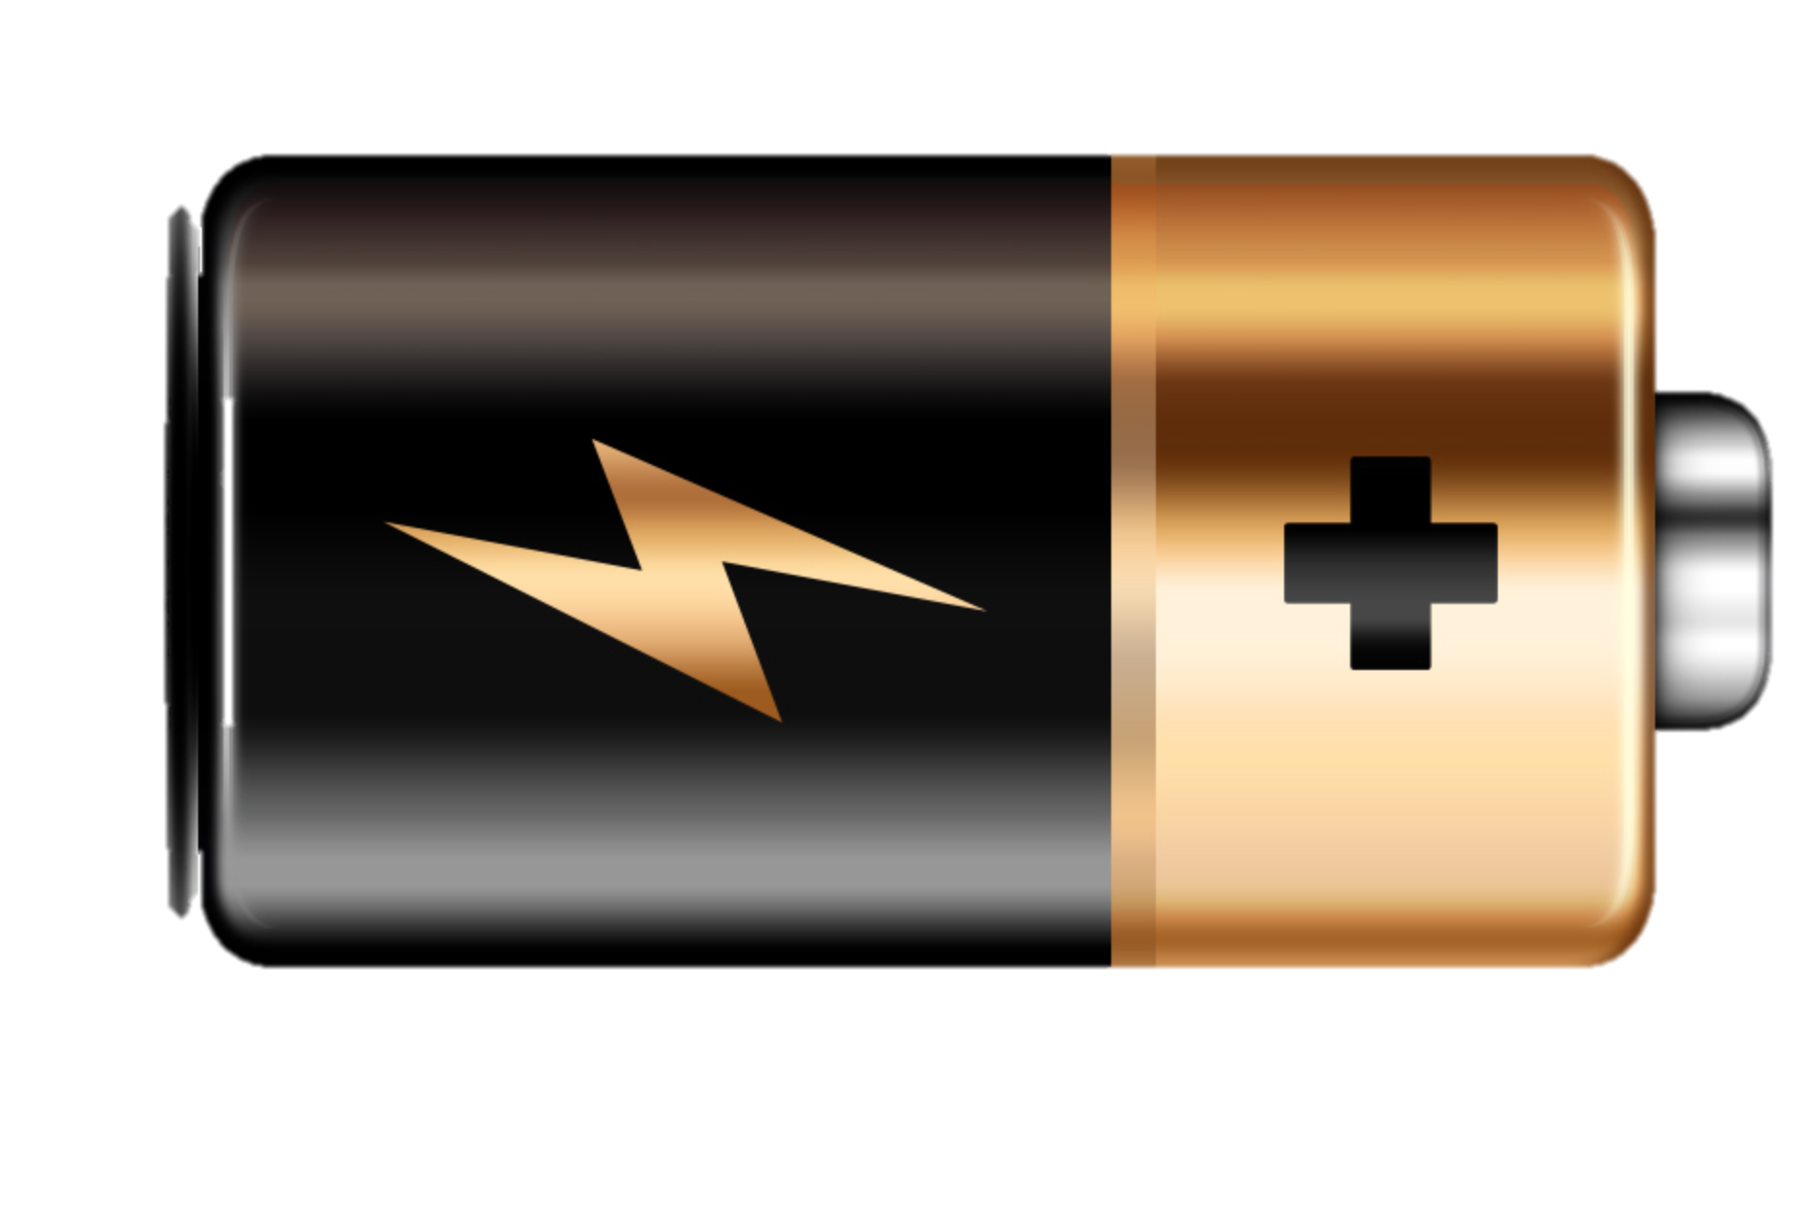
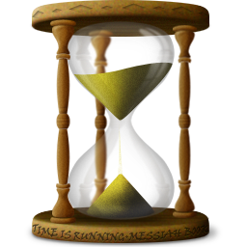

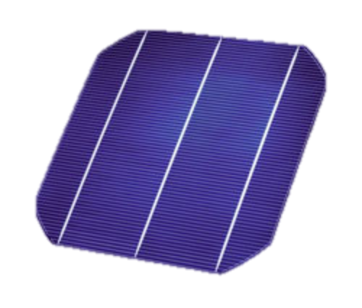
Energy budget defines capabilities (and requirements dictate energy budget)
Plug it in!
Power grid can be unreliable
Requires nearby available wiring
Who pays?
Put a battery in it
Battery == Lifetime
Low-power design or a big battery
What about solar?
Energy harvesting often most expensive
Requires lowest-power design

Slide 16
The cost / performance tradeoff spans 2-3 orders of magnitude
“An embedded sensor is like a computer from
the ’70s with some neat sensors attached”
and lasts a year+ on a battery
“A smartphone is like a mini-PC in your pocket”
and lasts a day on a battery

Slide 17
The cost / performance tradeoff spans 2-3 orders of magnitude
“An embedded sensor is like a computer from
the ’70s with some neat sensors attached”
“A smartphone is like a mini-PC in your pocket”
They are priced appropriately

Slide 18
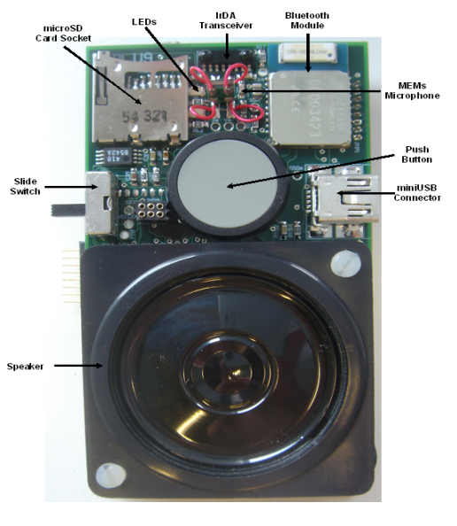
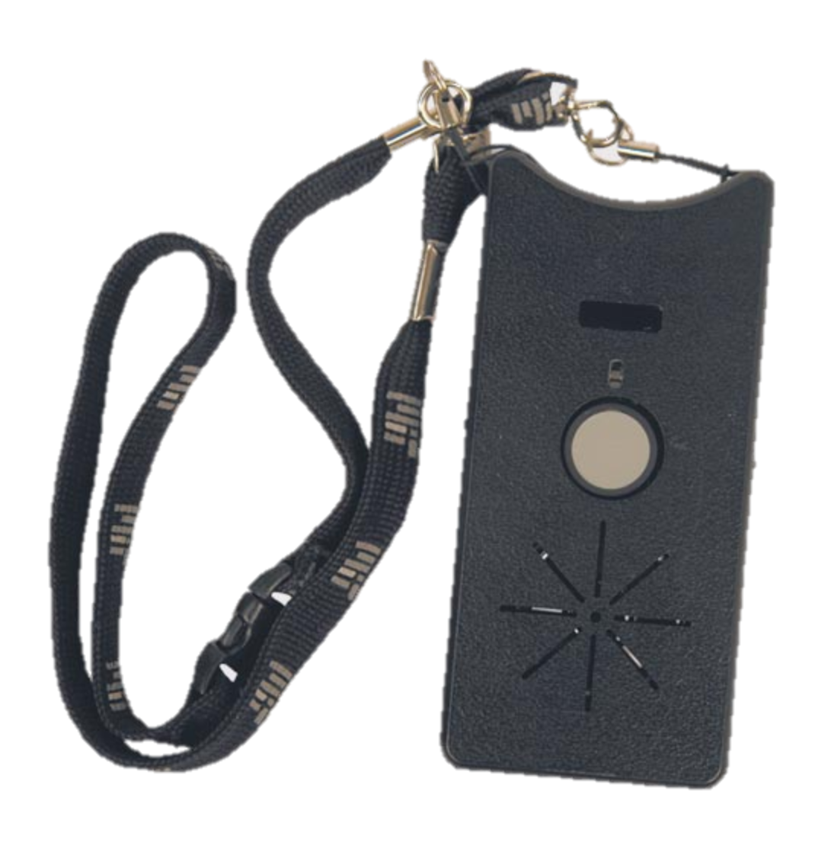
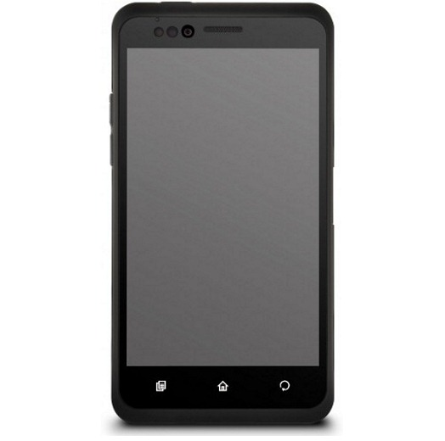
Smartphones have a diverse array of powerful sensors
Smartphones have a diverse array of powerful sensors
Accelerometer, Gyroscope, Magnetometer, GPS, camera…
And communication (cellular, WiFi, Bluetooth, NFC) is built in
Pentland ‘06
Pentland ‘07
Pentland ‘09

Slide 19
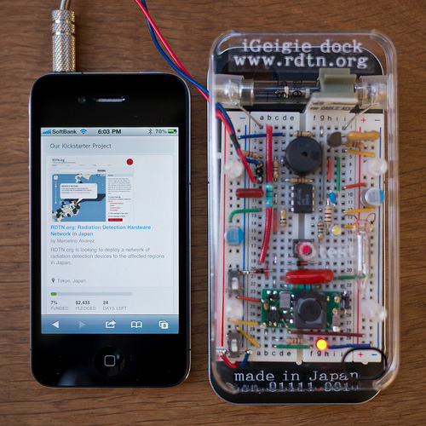
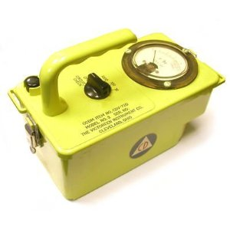
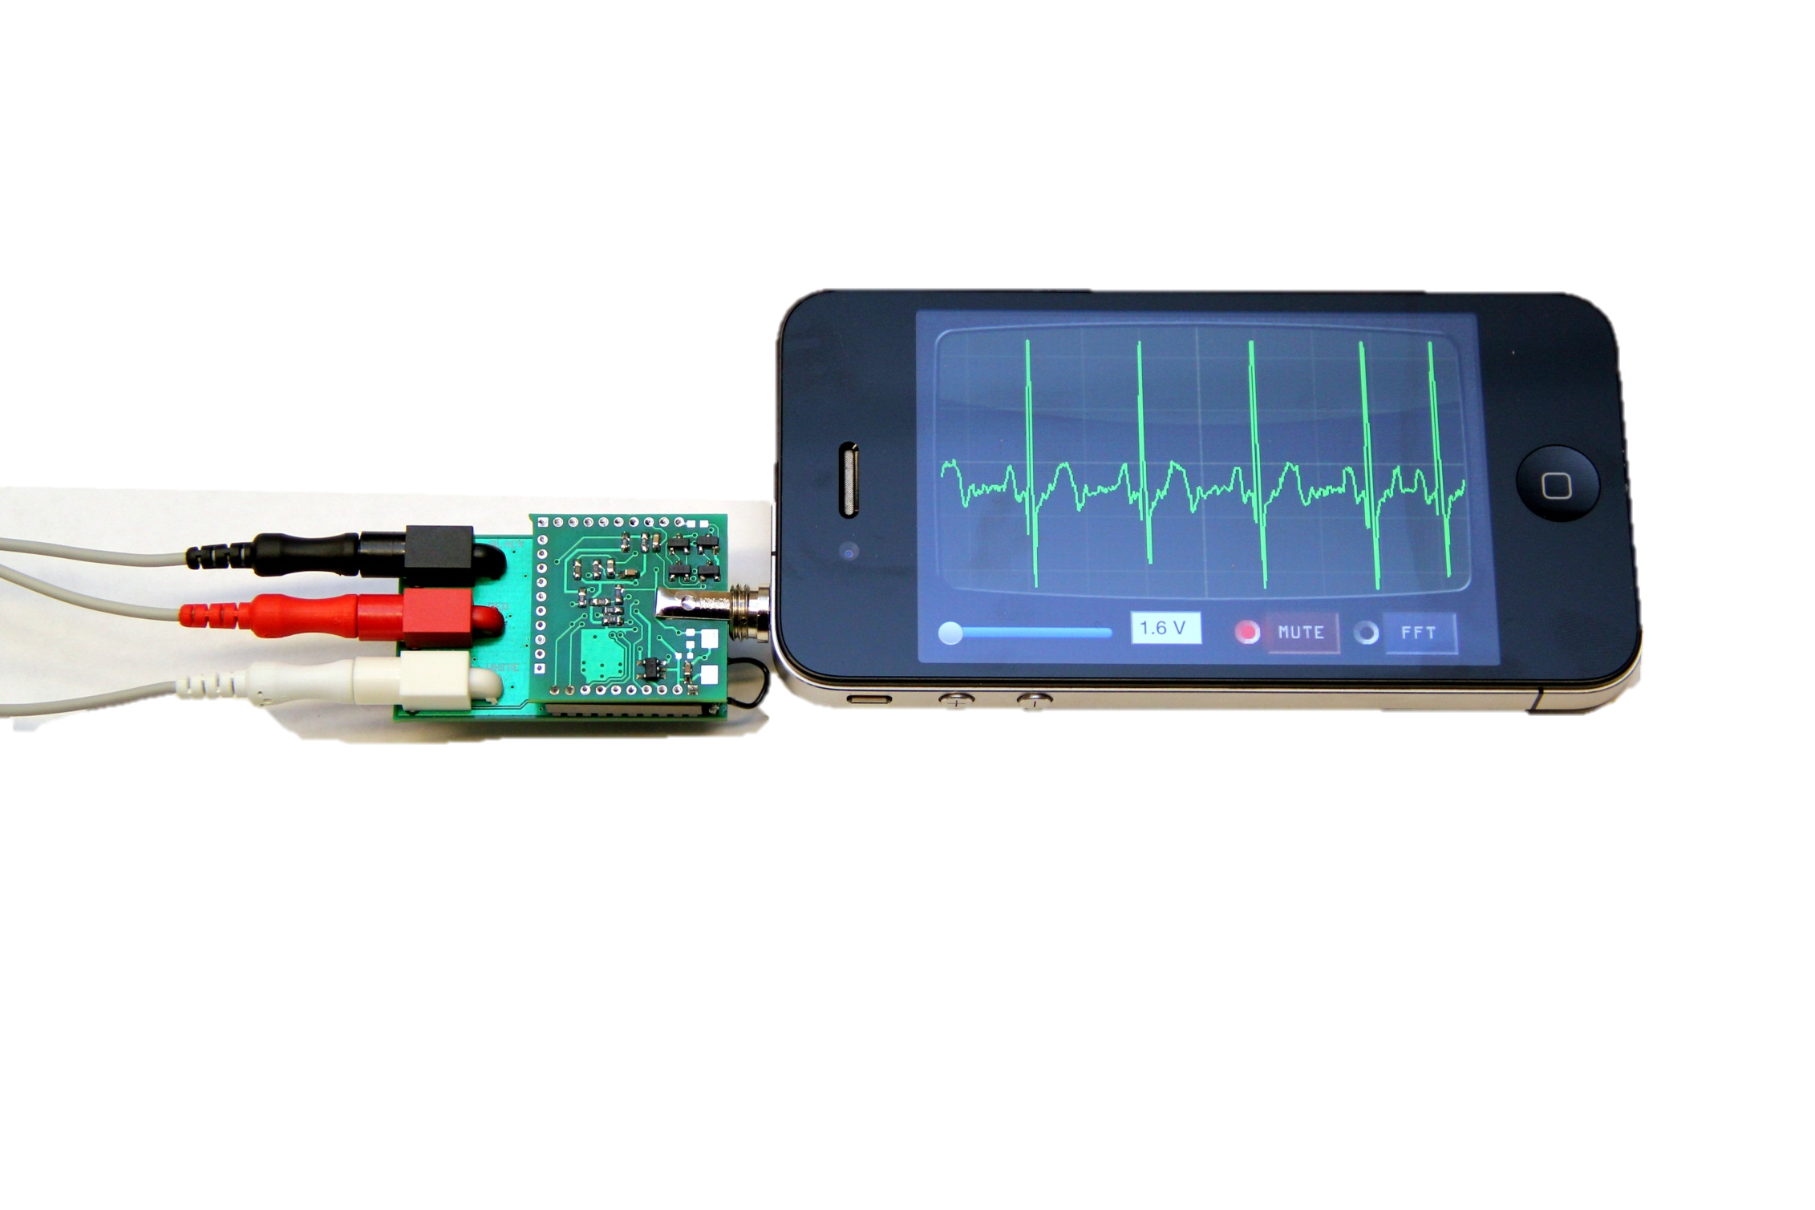
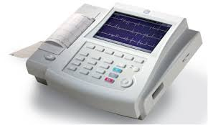
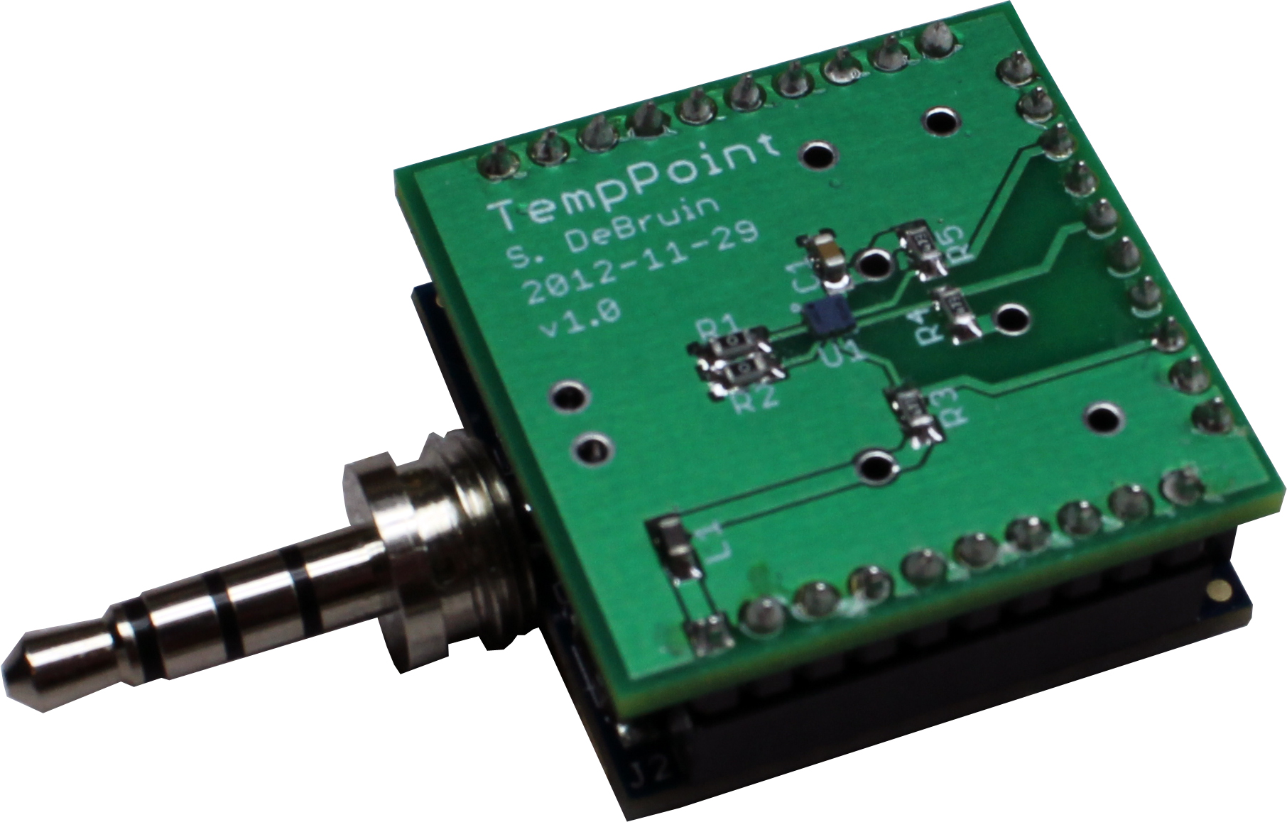
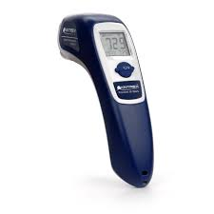
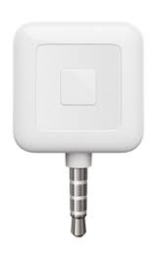
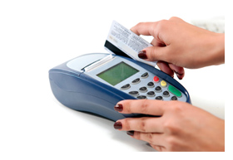
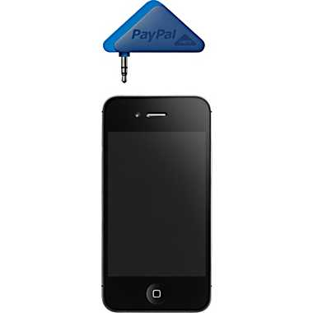
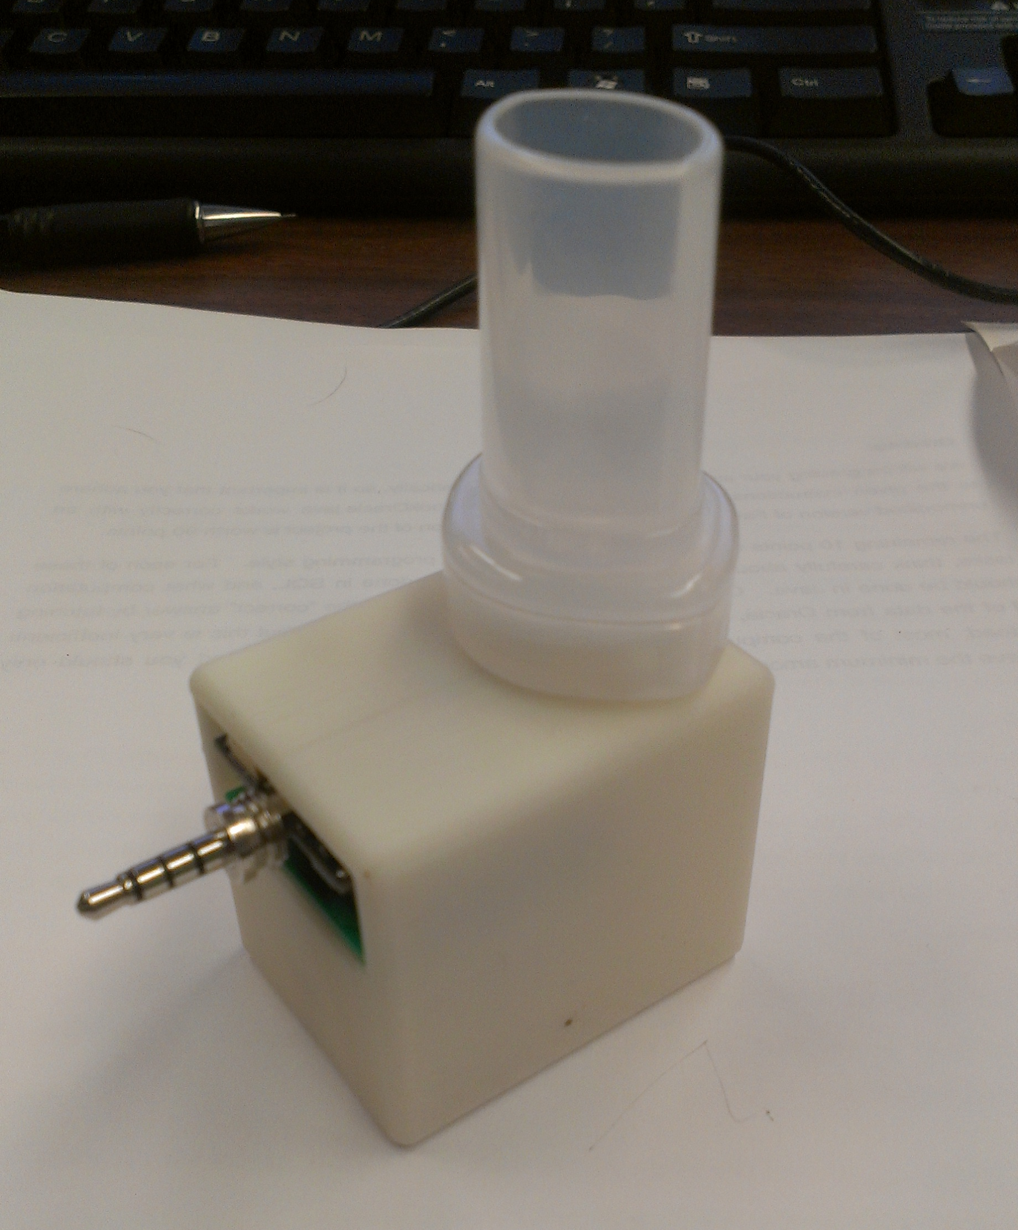
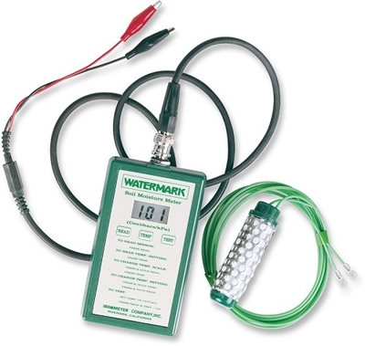
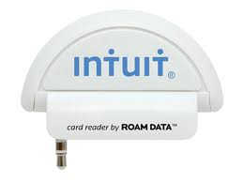
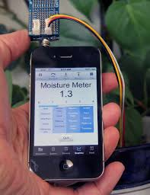
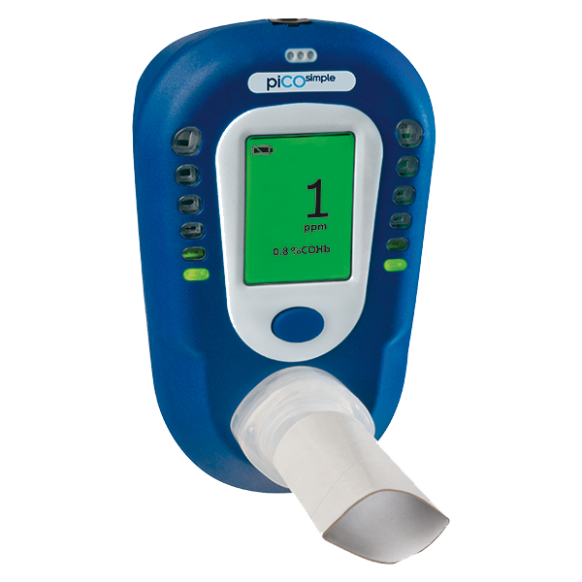
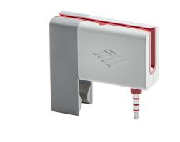
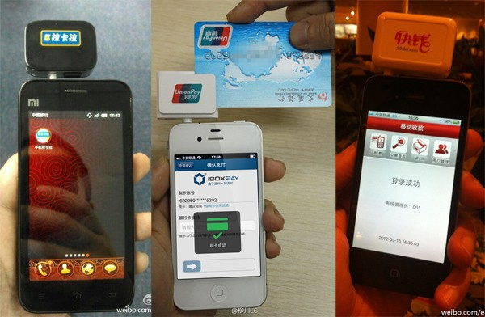
HiJack: Augmenting smartphones to add “missing” sensors
Geiger Counter
EKG Monitor
Thermometer
CC Terminal
Soil Moisture
CO Sensor
[slide courtesy Prabal Dutta]

Slide 20
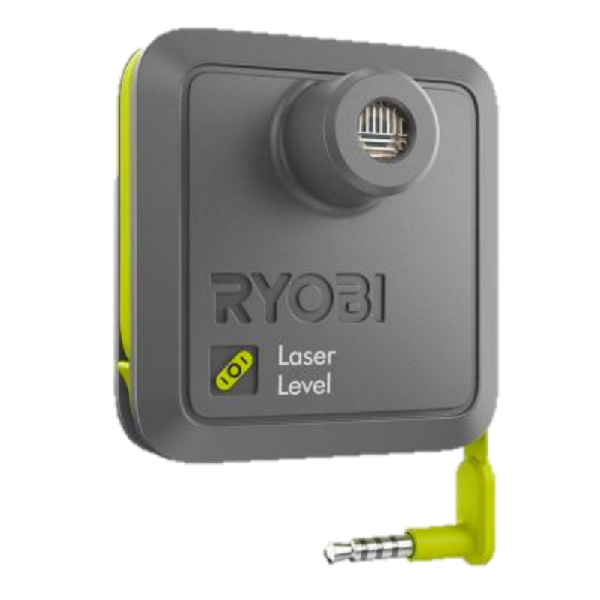
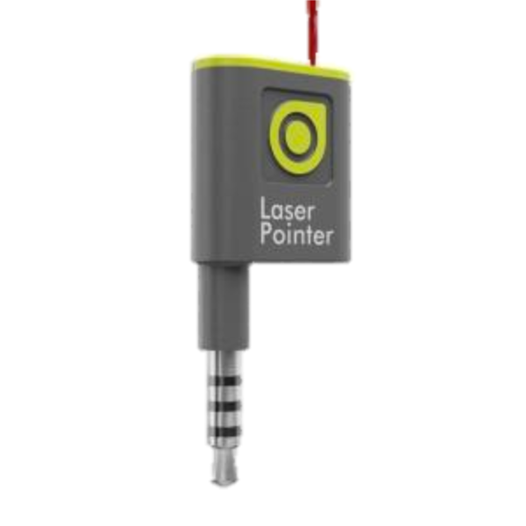
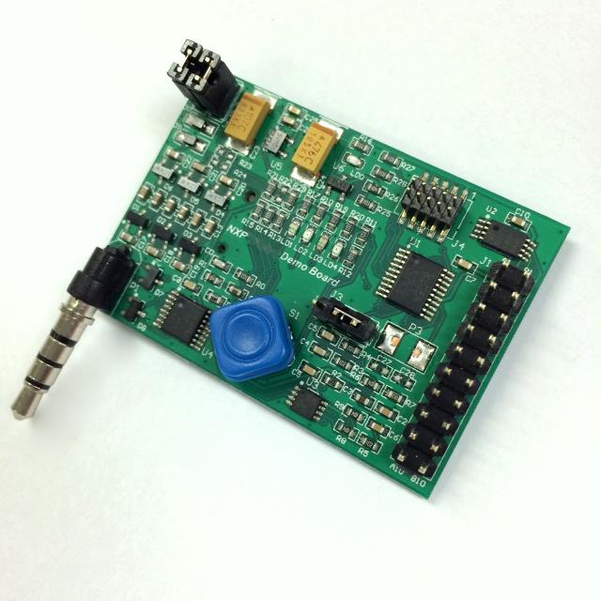
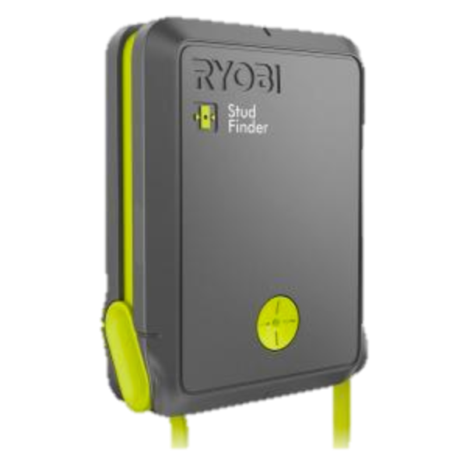
HiJack → QuickJack → PhoneWorks
Commercial development kit available, mass market products
Images from NXP, Home Depot

Slide 21
Smartphones are expensive to deploy
General purpose device: you pay for what you don’t use
Power limitations means the phone is tethered
Unless “attached” to a user, that is, crowdsourcing
Communication options only cellular, Wi-Fi, Bluetooth
Make sense in 10s-100s, maybe not 1000s
But can be re-used / re-purposed

Slide 22
How to think like an embedded systems engineer
Or, how to do better than a smartphone for less money?
Goal: Understand the tradeoffs in the embedded design space, what is feasible, what isn’t feasible.

Slide 23
How much local storage do you need?
It’s never zero
How much data are you willing to lose?
“Batch”, “Delay-Tolerant”, “Best-Effort”
Memory quickly drives microcontroller cost
RAM from 16~128 kilobytes
Flash memory
SD cards are cheap, easy to interface with
Flash chips can be cheaper, more work to integrate; read
What do you do when you run out of space?

Slide 24
How do you get continuous data off of devices?
What data backhaul is available?
Ethernet? Wi-Fi? Cellular (data, voice, text)? Satellite?
How reliable is it?
(again, how much data are you willing to lose?)
Who Pays??
Communication is often 80%+ of energy budget
Defines battery size / system lifetime
Notes:
Who pays – buy SIMs? Pay users per report? How to share internet uplink? App-based BW-metering is really hard. Satellite is really expensive.

Slide 25
Is there anything that can make communication more efficient?
Costs less energy to send a smaller distance (usually)
e.g. Wi-Fi uses less energy than cellular
Mesh Networks
Popular in wireless sensor network research
Hard to make reliable in practice for battery-backed devices
iOS 7 adds support for Wi-Fi based mesh networking
Not used much yet, something to watch
Early reports are many of the same difficulties as WSNs

Slide 26
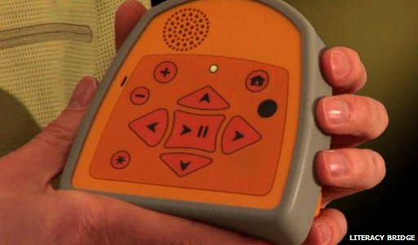

Taking it to the extreme: Full-custom design of a $25 “radio DVR”
FM receiver that records broadcast lessons
Users can record programs and share them
http://www.bbc.com/news/technology-30127578
http://web.eecs.umich.edu/~prabal/pubs/papers/foo13lit.pdf

Slide 27



Taking it to the extreme: Full-custom design of a $25 “radio DVR”
http://www.bbc.com/news/technology-30127578
http://web.eecs.umich.edu/~prabal/pubs/papers/foo13lit.pdf

Slide 28




Wireless sensor networks are young technology
The field is 15-20 years old
Maker culture creating some accessible technology
Notes:
“arduino battery life”: https://hwstartup.wordpress.com/2013/03/11/how-to-run-an-arduino-on-a-9v-battery-for-weeks-or-months/
Tessel consumes about 1 Watt when it has the CC3000 WiFi radio enabled and is running blinky.js.
Pinnocio – 27 hours full bore; claims duty cycling. Radio = 17 mA.

Slide 29

GridWatch: Crowdsourcing power grid health monitoring
Insight: You pick up your phone to unplug it
Power loss without motion is likely a power outage
[GridWatch HotMobile ‘14]

Slide 30



Smoking Cessation with Monoxalyze
Smoking Cessation programs lack feedback
Q: Did you smoke today?
A: No, of course not!
Carbon Monoxide levels reveal smoking within 4-6 hours
Gen 2: Wireless (BLE), Authenticated

Slide 31




Human interaction tracking and social graph building with Opo
Fine-grained human interaction data
Who did you talk to today?
For how long?
10 cm accuracy with 1 week battery
Applications in sociology, immunology
A Week as a PhD Student
Wearable
Accurate
Detailed
1.6 cm
Small form factor
Ranging Accuracy Test
Two Person Interaction

Slide 32








Wearabouts: Leveraging wearable electronics for building occupancy
Most emit beacons we can listen for
Wearables are everywhere….
Which we use to locate people in space

Slide 33




The Monjolo Principle Combining non-traditional sensing and energy harvesting
Harvest side-channels of energy – wakeup frequency is the sensor
[Monjolo, Sensys ‘13]

Slide 34
Takeaways
Anything can be sensed, but it may require creativity
Distinguish what you want to know from what you need to measure to answer the question
Constraints on data-collection define the rest of your system
Or at the least are a very good place to start
Smartphones are useful, but not a panacea
And can be costly (though re- and multi-purposeable)

Slide 35


Contact and More Information
Pat Pannuto
pat.pannuto@gmail.com
http://patpannuto.com
[slides on my website]
Lab11
http://lab11.eecs.umich.edu
http://github.com/lab11
Prabal Dutta
http://eecs.umich.edu/~prabal

